Slide 1
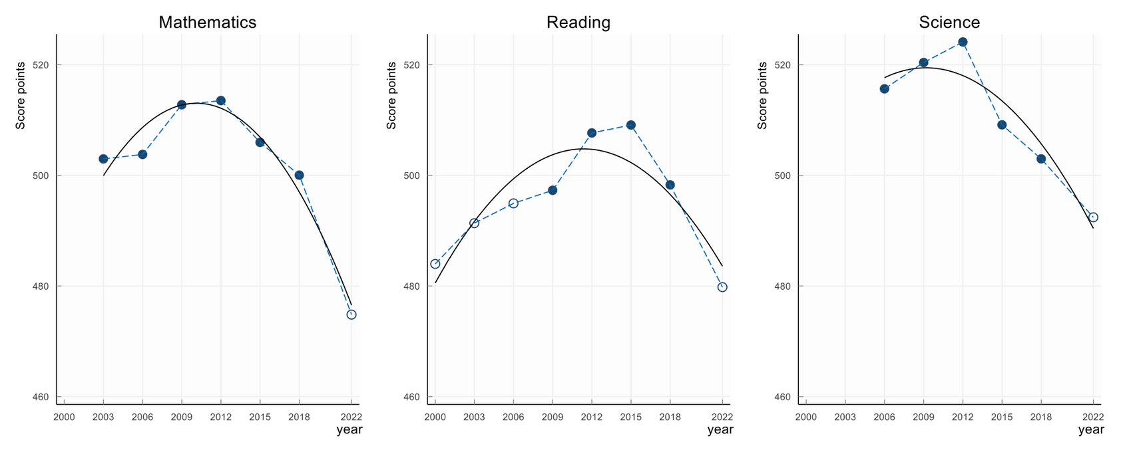
01
Knowledge and skill trends of 15- year-old students in Germany
2022 PISA results - significant decline across mathematics, reading, and science compared to 2018
lowest scores recorded in all three subjects.
Source: PISA Study 2022, OECD

Slide 2
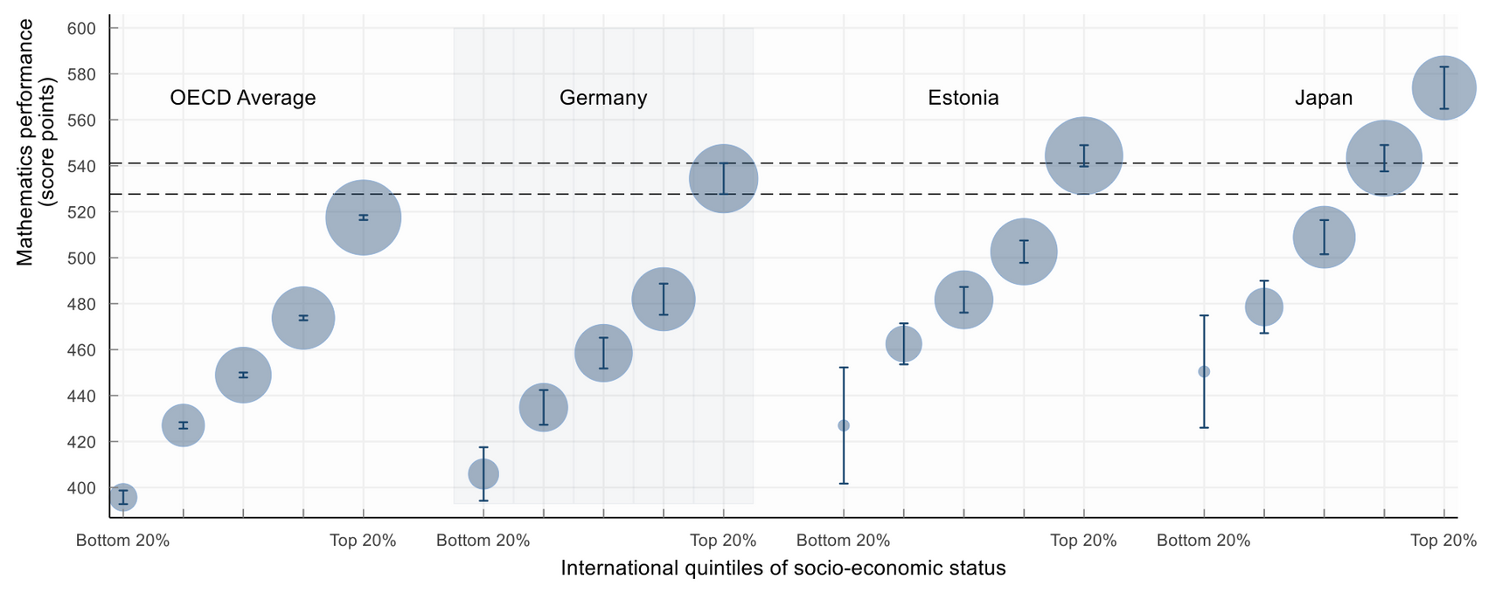
02
Socio-economic divides and Immigration Background Disparities
Socio-economic status and immigration background significant influence
Advantaged students outperforming disadvantaged
Immigrant students demonstrating lower performance levels (after adjusting for socio-economic factor)
Source: PISA Study 2022, OECD

Slide 3
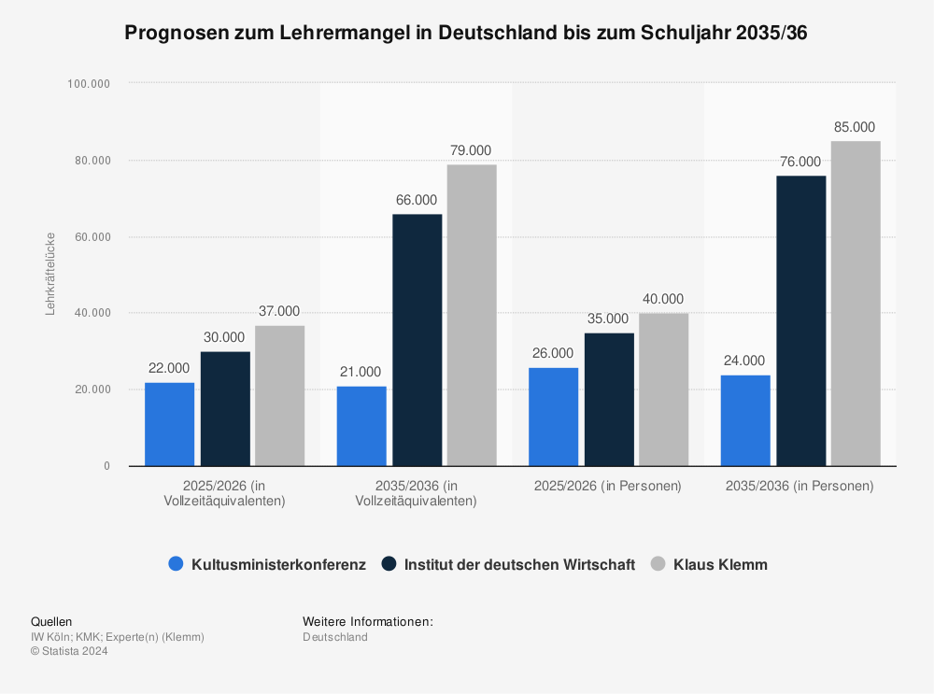
TEACHER SHORTAGE GERMANY
Anticipated teacher shortages escalating
widening gap between demand and available educators.
03

Slide 4
04
Our Goal:
Empowering Every Student and Teacher by utilising generative AI in Education

Slide 5
Learning material
Student’s input
AI’s feedback
Teachers implementing suggestions
Solutions Architecture
Seamless flow of data
AI-driven infrastructure
Evidence-Based Decision Making
Generating actionable insights
Foster continuous improvement
05

Slide 6
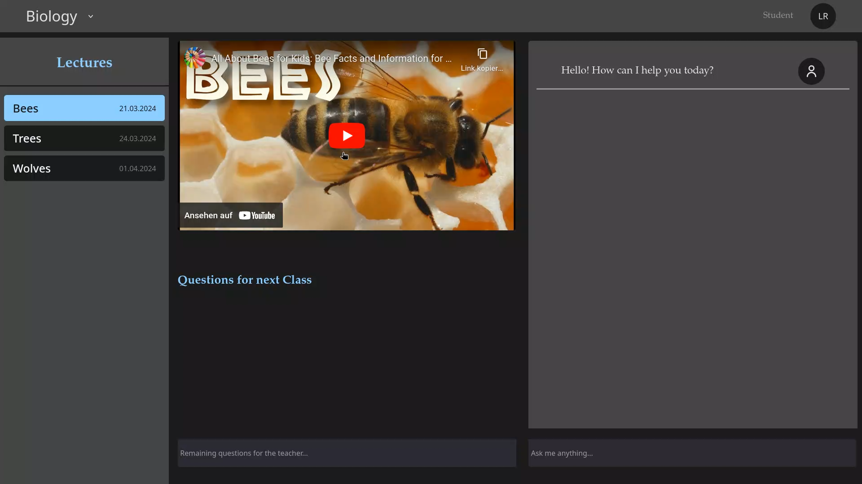

Slide 7
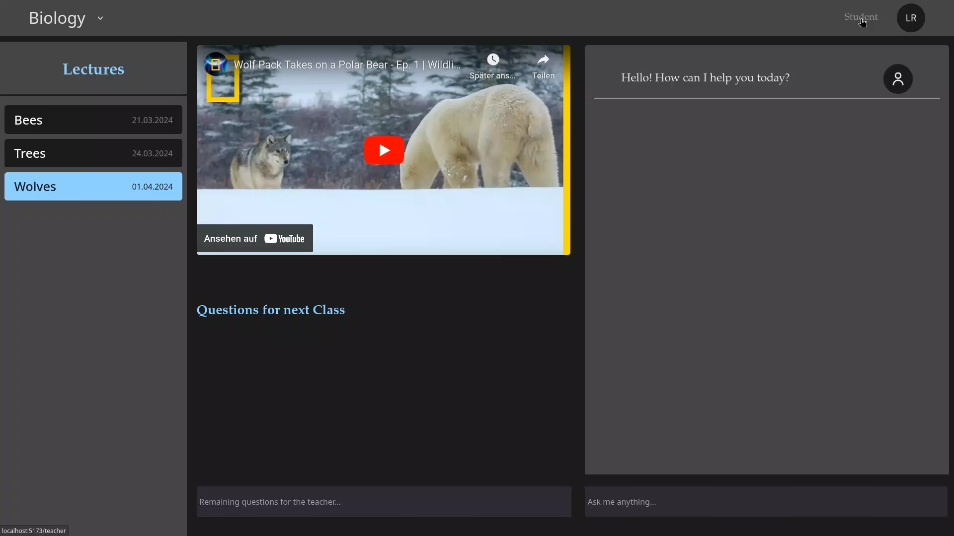
TEACHER SHORTAGE GERMANY
Anticipated teacher shortages in Germany are projected to escalate steadily until the 2035/36 school year, with estimates suggesting a widening gap between demand and available educators.
07

Slide 8
08
Outlook
Personalization through Generative AI
AI creating improved learning materials
Including broader range of resources
Including selected Youtube channels
Utilizing platform-wide data
Improving learning material on a platform-wide scale

Slide 9
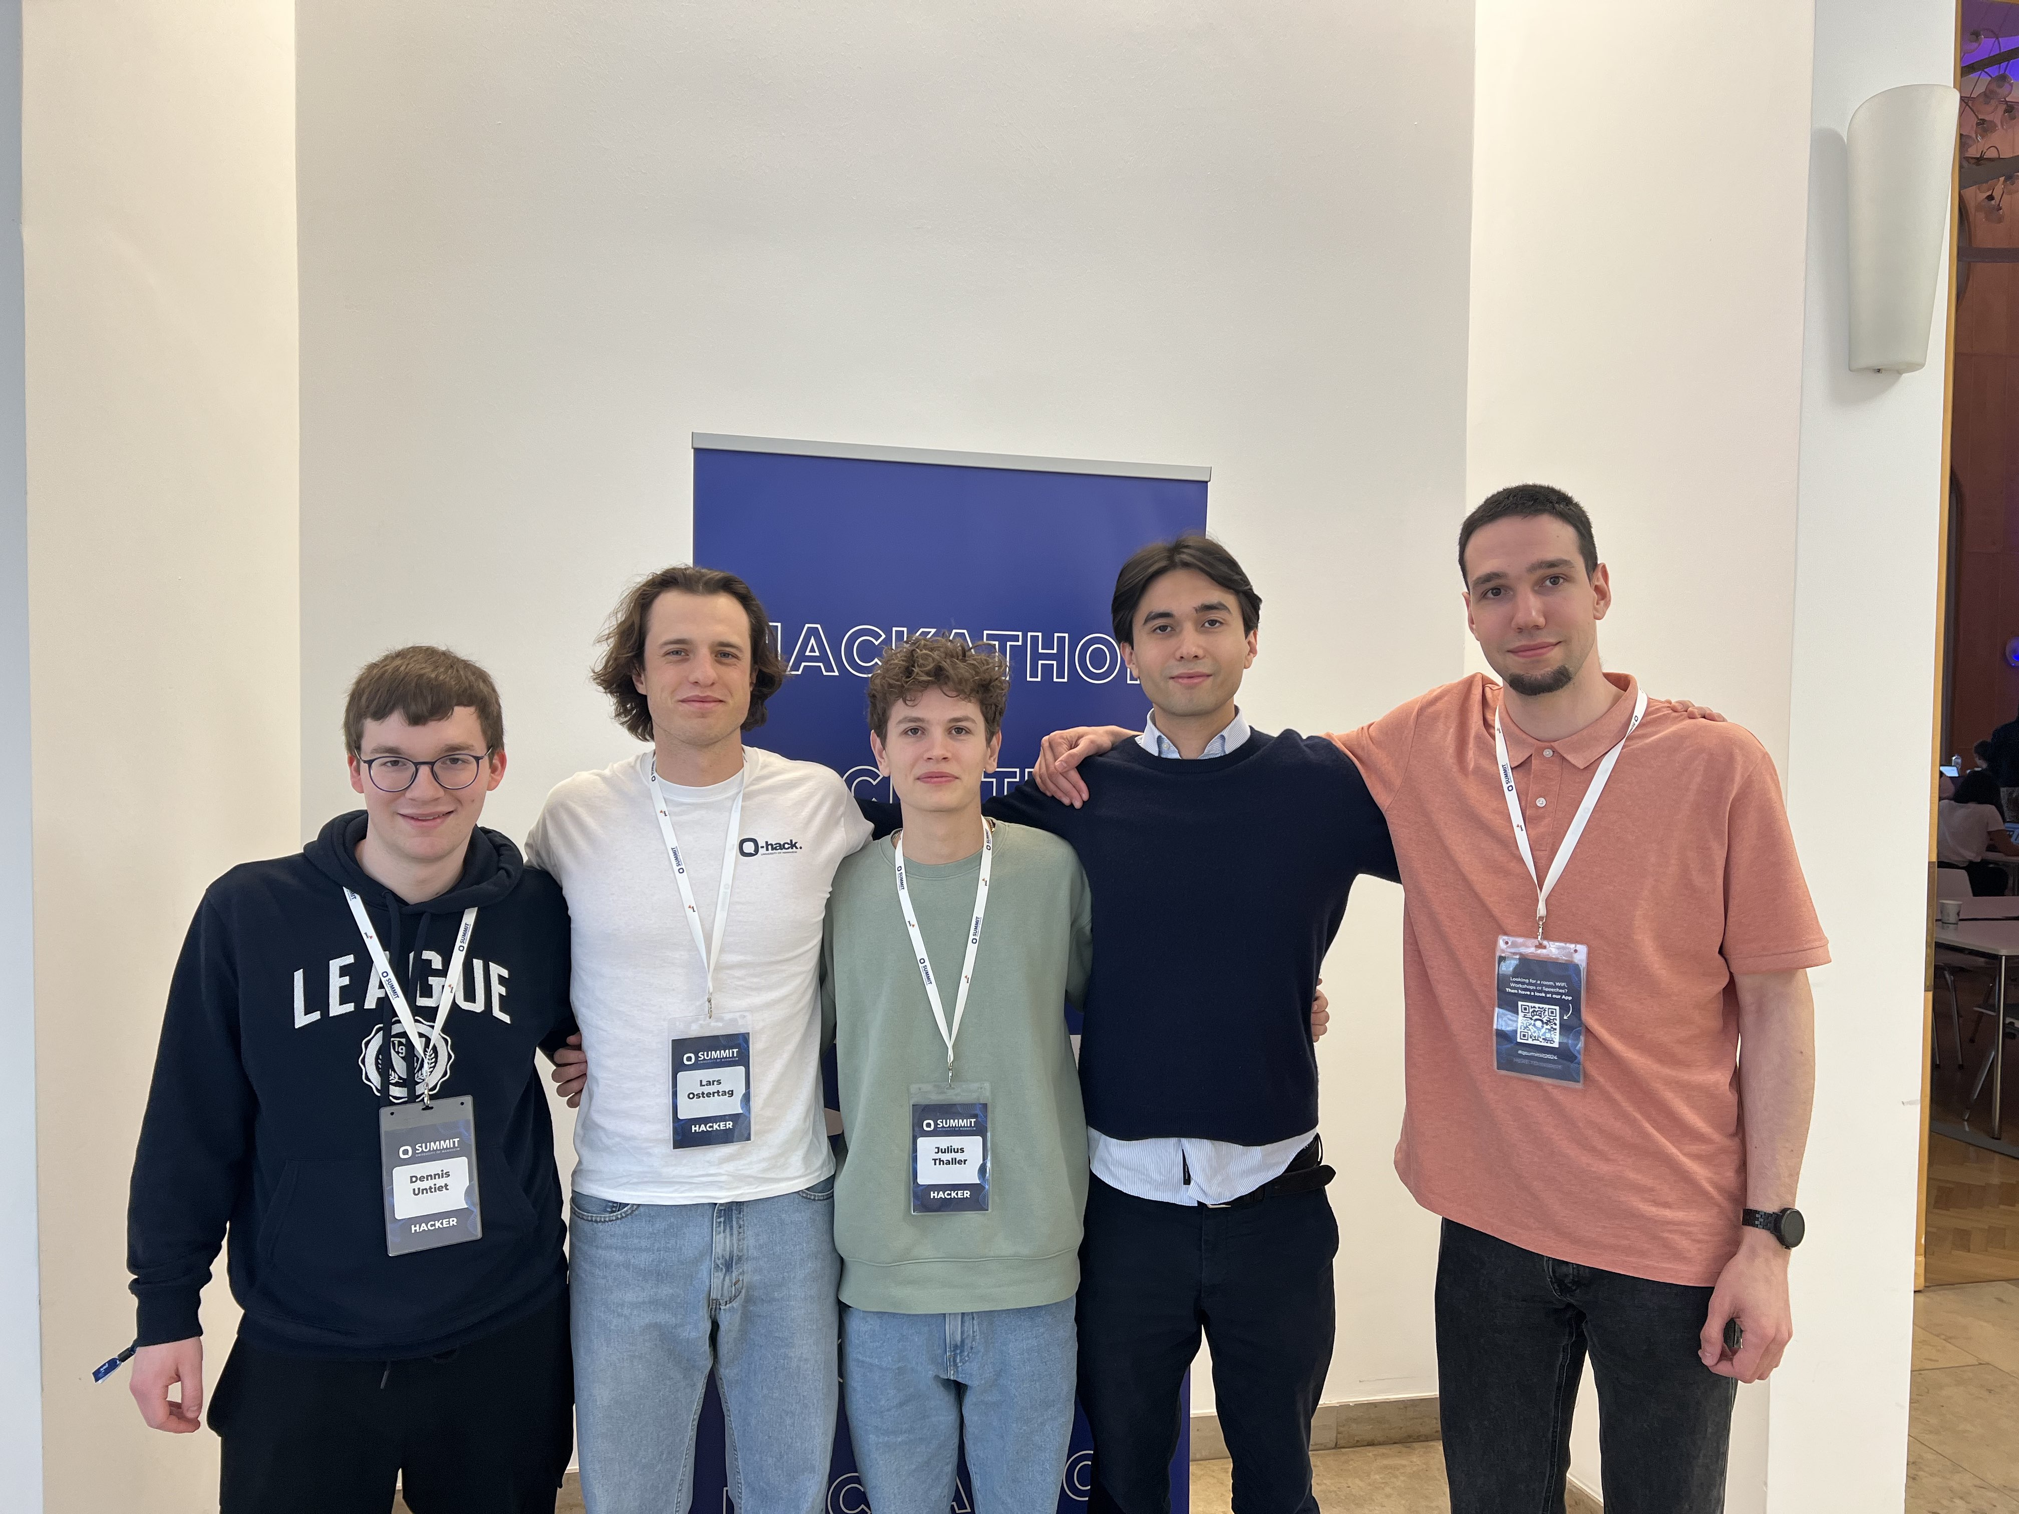
09
Code Gardeners
Meet us at table 4
IBM Challenge Q-Hack ‘24

Slide 10
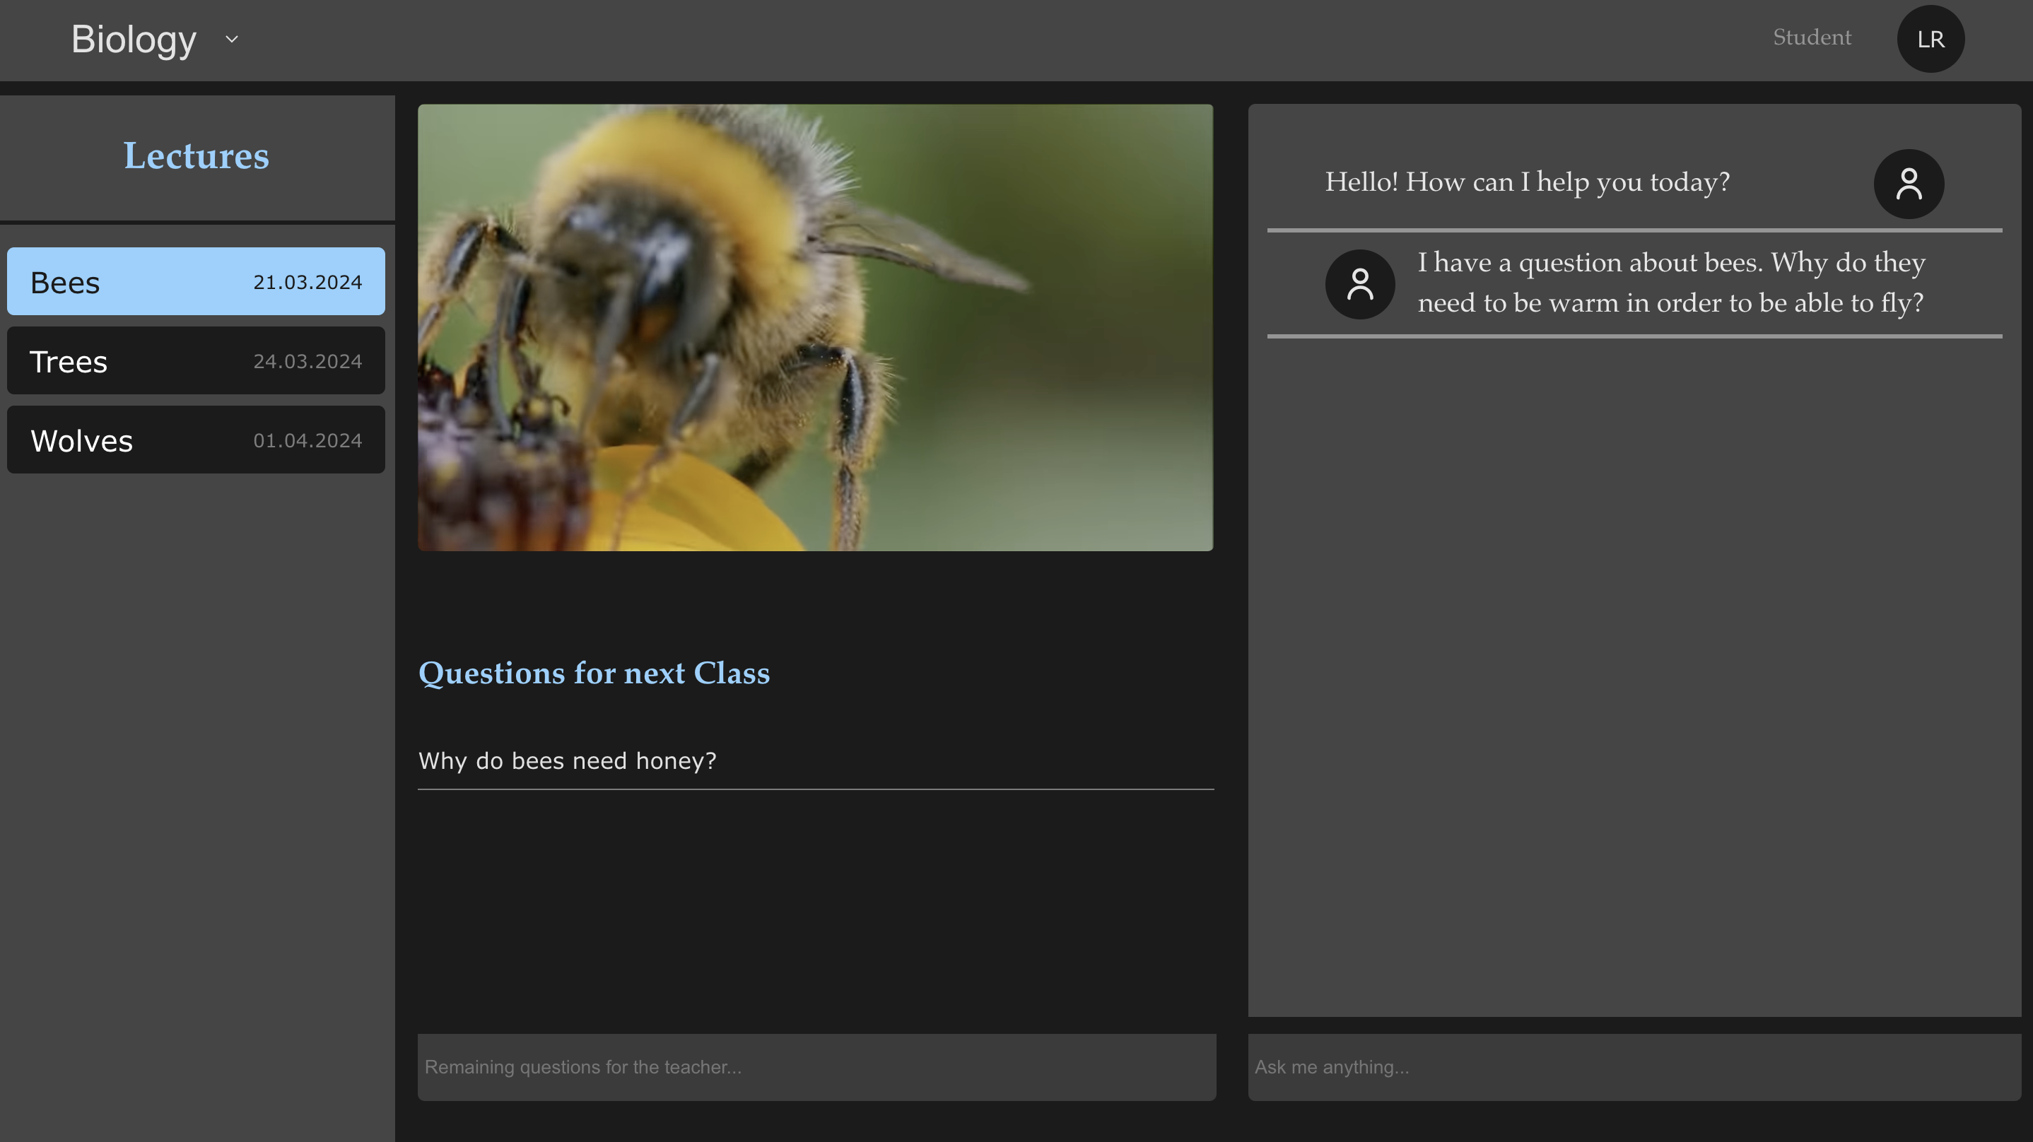

Slide 11
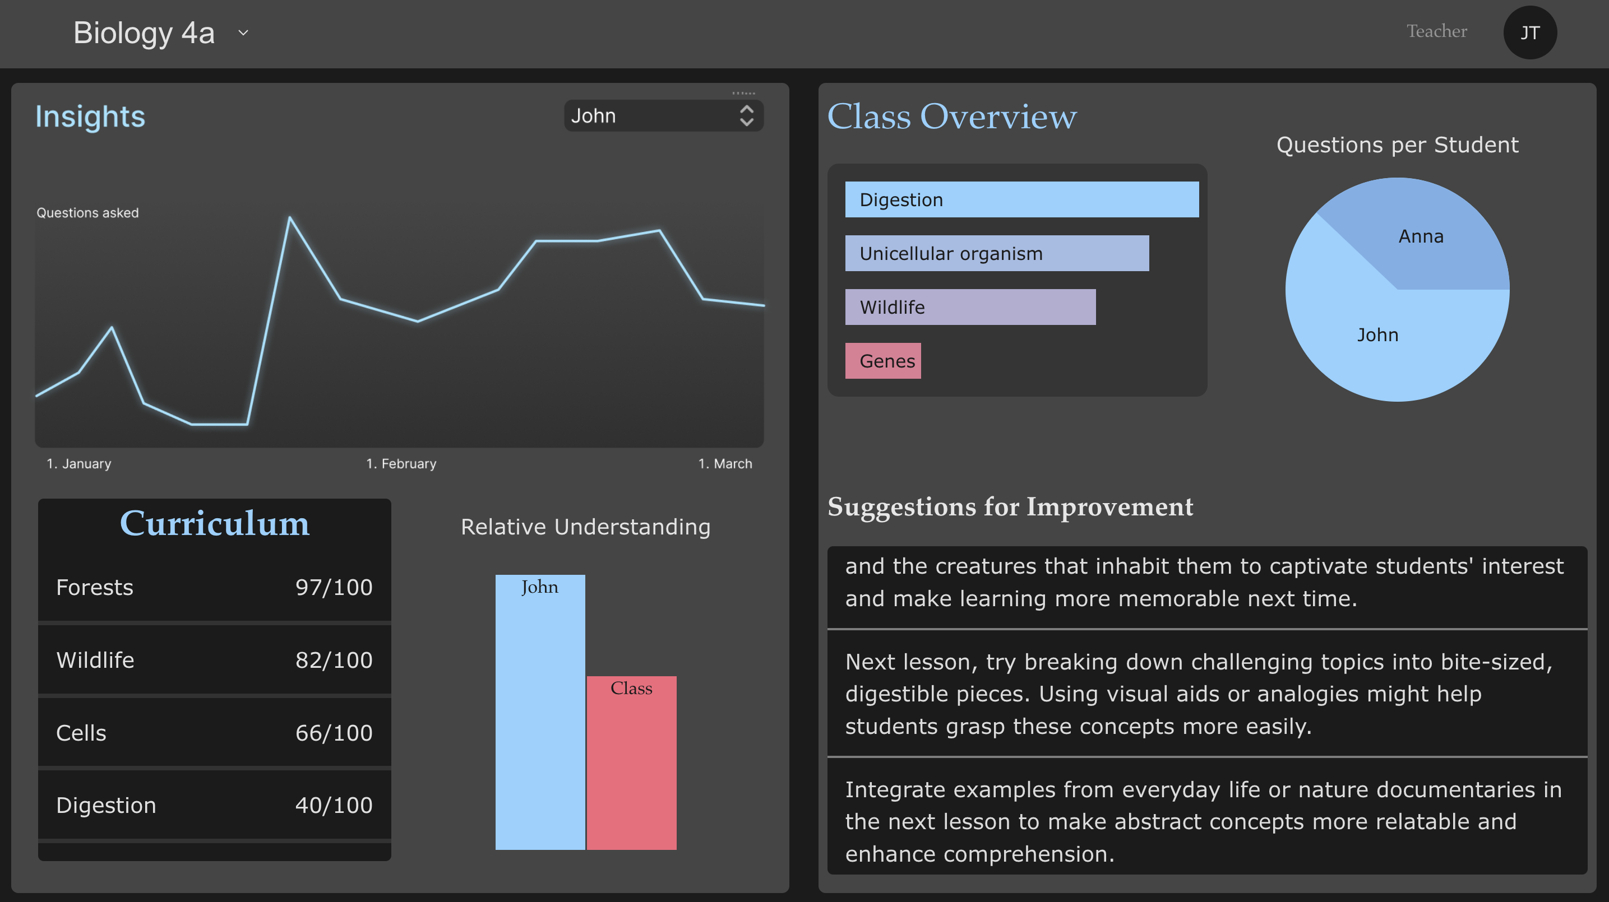

Slide 12
